Slide 1
Graphs
  1. Terminology
  2.

Slide 2
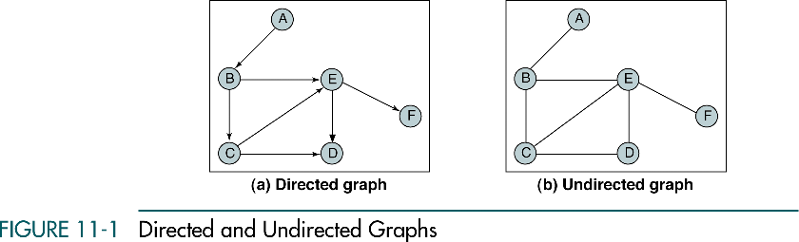
A graph is a collection of nodes, called vertices, and line
segments, called arcs or edges, connecting pair of nodes.
Data Structures: A Pseudocode Approach with C, Second Edition

Slide 3
Linear List: each node, except the last, has a unique successor.

Slide 4
Linear List: each node, except the last, has a unique successor.
Tree: each node, except the root, has one predecessor
and may have multiple successors.

Slide 5
Linear List: each node, except the last, has a unique successor.
Tree: each node, except the root, has one predecessor
and may have multiple successors.
Graph: each node may have multiple predecessors as well
as multiple successors.

Slide 6
Graph: each node may have multiple predecessors as well
as multiple successors.

Slide 7
Undirected graph
(graph)
A
A
B
B
NO edge!
ONE edge!

Slide 8
Directed graph
(digraph)
A
A
A
A
B
B
B
B
NO arc!
ONE arc:
(from A to B)
ONE arc:
(from B to A)
TWO arcs:
AB and BA

Slide 9
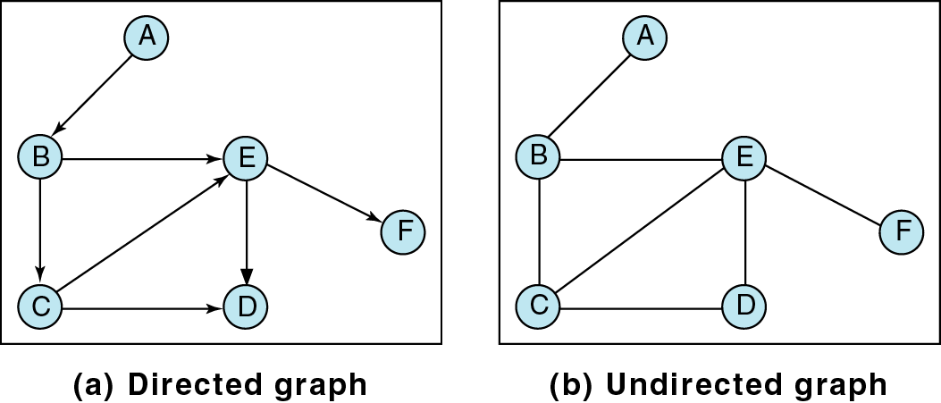
Vertices adjacent to C?

Slide 10
Vertices adjacent to C:
B, E, and D

Slide 11
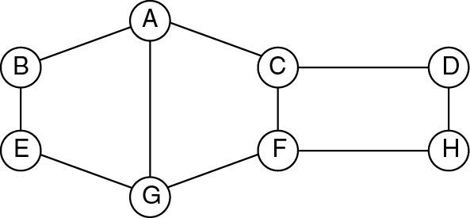
Nodes adjacent to
Node A
Node F
Node G

Slide 12
A graph can be used to show relationships. For example, given the following list of people belonging to the same club (vertices)
People = { George, Jim, Jean, Frank, Fred, John, Susan}
and friendships (edges),
Friendship = { (George, Jean), (Frank, Fred), (George, John), (Jim, Fred), (Jim, Frank), (Jim, Susan), (Susan, Frank) }
Find
All friends of John.
All friends of Susan.
All friends of friends of Jean.
All friends of friends of Jim.

Slide 13
Jean
George
Jim
Fred
Susan
John
Frank
All friends of John?

Slide 14
Jean
George
Jim
Fred
Susan
John
Frank
All friends of John: George

Slide 15
Jean
George
Jim
Fred
Susan
John
Frank
All friends of Susan?

Slide 16
Jean
George
Jim
Fred
Susan
John
Frank
All friends of Susan: Frank, Jim

Slide 17
Jean
George
Jim
Fred
Susan
John
Frank
All friends of friends of Jean?

Slide 18
Jean
George
Jim
Fred
Susan
John
Frank
All friends of friends of Jean: John (Jean)

Slide 19
Jean
George
Jim
Fred
Susan
John
Frank
All friends of friends of Jim?

Slide 20
Jean
George
Jim
Fred
Susan
John
Frank
All friends of friends of Jim: Frank, Susan, Fred (Jim)

Slide 21
Path(s) from A to D?

Slide 22
Path(s) from A to D:
A B E D
Path(s) from A to D:
A B E D

Slide 23
Path(s) from A to D:
A B E D
A B C D
Path(s) from A to D:
A B E D
A B C D

Slide 24
Path(s) from A to D:
A B E D
A B C D
A B C E D
Path(s) from A to D:
A B E D
A B C D
A B C E D

Slide 25
Path(s) from A to D:
A B E D
A B C D
A B C E D
Path(s) from A to D:
A B E D
A B C D
A B C E D
A B E C D

Slide 26
Find all non-cyclic paths
from A to H
from C to E
from B to F

Slide 27
Cycle: Path that starts and ends with the same vertex.
Cycle(s) that starts and ends with C?

Slide 28
Cycle(s):
C E D C, C D E C
NO cycles!

Slide 29
Cycle(s):
C E D C, C D E C
C B E C, C E B C
NO cycles!

Slide 30
Cycle(s):
C E D C, C D E C
C B E C, C E B C
C B E D C, C D E B C
NO cycles!

Slide 31
Degree of node C?
Indegree of node C?
Outdegree of node C?

Slide 32
Degree of node C: 3
Indegree of node C: 1
Outdegree of node C: 2
Degree of node C: 3
Indegree of node C: 3
Outdegree of node C: 3

Slide 33
Degree of:
  Node A
  Node E
  Node F
  Node G
  Node H

Slide 34
Beginning of the graph theory?

Slide 35
The Königsberg (Kaliningrad) bridge problem asks if the seven
bridges of the city of Königsberg can all be traversed in a
single trip without doubling back.
This problem was answered in 1736 by Euler, and represented
the beginning of graph theory.

Slide 36
A
A
E
D
E
D
B
B
C
C
Is it possible to trace this graph, starting and ending at the same
node, without ever lifting your pencil from the paper?

Slide 37
A
A
E
D
E
D
B
B
C
C
Is it possible to trace this graph, starting and ending at the same
node, without ever lifting your pencil from the paper?
Is it possible to find a route through the graph that starts and ends
at one of its vertices, and traverses each edge once?

Slide 38
A
A
E
D
E
D
B
B
C
C
One solution:
A-B-C-E-A-C-D-A
(Euler circuit)
No solution:
A-B-C-E-A-D-C- ?

Slide 39
A
A
E
D
E
D
B
B
C
C
A graph has an Euler circuit if, and only if,
- the graph is connected and
- every node has an even degree.

Slide 40
The Hamiltonian cycle problem is one of the most famous in graph theory. It seeks a tour that visits each vertex of a given graph exactly once. It has a long history and many applications.
In 1859 the Irish mathematician, Sir Wm. Hamilton introduced a puzzle in the shape of a dodecahedron: 12 identical pentagonal faces. Each vertex was labeled with the name of a city. The problem posed was to start at one city and tour the world by visiting each other city once, returning to the starting city.

Slide 41
A
A
E
D
E
D
B
B
C
C
One solution:
A-B-C-E-D-A
(Hamiltonian circuit)
No solution:
A-B-C-E- ?

Slide 42
The problem of finding a hamiltonian cycle in an undirected
graph has been studied for over a hundred years.
There is no efficient algorithm for finding such a circuit.

Slide 43
Depth-first traversal starting from vertex A:

Slide 44
Depth-first traversal starting from vertex A:
A G F H D E C B

Slide 45
Depth-first traversal starting from vertex A:
A G F H D E C B
A C D H F G E B (?)

Slide 46
Breadth-first traversal starting from vertex A:
Data Structures: A Pseudocode Approach with C, Second Edition

Slide 47
Breadth-first traversal starting from vertex A:
A B C G E D F H

Slide 48
Graph Traversals: Applications
Most of the simple graph algorithms are based on one of the
two graph traversals.
Both breadth-first and depth-first traversals run in O(n+m) on
directed/undirected graphs
n – number of nodes
m – number if edges/arcs

Slide 49
Breadth-First Traversal:
  1. Finding all connected components in a graph.
  2. Testing a graph for bipartiteness
  3. Finding the shortest path between two nodes
Depth-First Traversal:
  1. Finding all connected components in a graph.
  2. Finding strongly connected components
  3. Solving maze problems

Slide 50
Breadth-First Traversal:
  1. Finding all connected components in a graph.
  2. Testing a graph for bipartiteness
  3. Finding the shortest path between two nodes
Depth-First Traversal:
  1. Finding all connected components in a graph.
  2. Finding strongly connected components
  3. Solving maze problems

Slide 51
  Finding all connected components in a graph (BFT/DFT)
A
G
H
E
D
F
X
B
Z
C
Y
L
P
Q
M

Slide 52
Breadth-First Traversal:
  1. Finding all connected components in a graph.
  2. Testing a graph for bipartiteness
  3. Finding the shortest path between two nodes
Depth-First Traversal:
  1. Finding all connected components in a graph.
  2. Finding strongly connected components
  3. Solving maze problems

Slide 53
  Finding the shortest path in a graph (BFT)
B
C
D
A
E
X
F
Y
H
G
When using a queue, the nodes are visited in order to their distance
from the starting node.

Slide 54
Breadth-First Traversal:
  1. Finding all connected components in a graph.
  2. Testing a graph for bipartiteness
  3. Finding the shortest path between
Depth-First Traversal:
  1. Finding all connected components in a graph.
  2. Finding strongly connected components
  3. Solving maze problems

Slide 55
A Traveling Salesperson Problem
A
50
50
55
70
D
B
60
45
C
A salesperson must travel to each city exactly once, starting
and ending in city A. Find a route that will minimize the total
distance that must be traveled.

Slide 56
A
50
50
55
70
D
B
60
45
C
ABCDA: 50 + 60 + 45 + 50 = 205 : ADCBA
ABDCA: 50 + 70 + 45 + 55 = 220 : ACDBA
ACBDA: 55 + 60 + 70 + 50 = 235 : ADBCA

Slide 57
A
50
50
55
70
D
B
60
45
C
ABCDA: 50 + 60 + 45 + 50 = 205 : ADCBA
ABDCA: 50 + 70 + 45 + 55 = 220 : ACDBA
ACBDA: 55 + 60 + 70 + 50 = 235 : ADBCA

Slide 58
A Traveling Salesperson Problem
A
50
50
55
70
D
B
60
45
C
For a complete graph with 30 vertices:
29! – different hamiltonian circuits starting and ending at a particular vertex.
1 microsecond per circuit => 2.8 x 10¹⁷ years

Slide 59
A Traveling Salesperson Problem
A
50
50
55
70
D
B
60
45
C
This algorithm has an exponential order.
There is no known algorithm for solving this problem that is
more efficient. However, there are algorithms that find "pretty
good" solutions.

Slide 60
Building a MST edge by edge!
A
10
10
15
10
D
B
20
15
C

Slide 61
Building a MST edge by edge!
A
10
10
15
10
D
B
20
15
C
BD = 10

Slide 62
Building a MST edge by edge!
A
10
10
15
10
D
B
20
15
C
BD = 10
AD = 10

Slide 63
Building a MST edge by edge!
A
10
10
15
10
D
B
20
15
C
BD = 10
AD = 10
AB – introduces a cycle!

Slide 64
Building a MST edge by edge – Kruskal's Algorithm
A
10
10
15
10
D
B
20
15
C
BD = 10
AD = 10
AB – introduces a cycle!
CD = 15
===
Total = 35

Slide 65
Minimum Spanning Tree Algorithm (three classical algorithms):
– Joseph B. Kruskal

Slide 66
Algorithm Design Techniques:
        Baktracking
        Greedy
        Divide and Conquer
        Dynamic Programming

Slide 67
Algorithm Design Techniques:
        Baktracking
        Greedy
        Divide and Conquer
        Dynamic Programming

Slide 68
Building a MST node by node!
A
10
10
15
10
D
B
20
15
C

Slide 69
Building a MST node by node!
A
10
10
15
10
D
B
20
15
C
AB = 10
AC = 15
AD = 10

Slide 70
Building a MST node by node!
A
10
10
15
10
D
B
20
15
C
AB = 10

Slide 71
Building a MST node by node!
A
10
10
15
10
D
B
20
15
C
AB = 10
AC = 15
AD = 10
BC = 20
BD = 10

Slide 72
Building a MST node by node!
A
10
10
15
10
D
B
20
15
C
AB = 10
AC = 15
AD = 10
BC = 20
BD = 10

Slide 73
Building a MST node by node!
A
10
10
15
10
D
B
20
15
C
AB = 10
AD = 10

Slide 74
Building a MST node by node!
A
10
10
15
10
D
B
20
15
C
AB = 10
AD = 10
AC = 15
BC = 20
DC = 15

Slide 75
Building a MST node by node!
A
10
10
15
10
D
B
20
15
C
AB = 10
AD = 10
AC = 15
BC = 20
DC = 15

Slide 76
Building a MST node by node – Prim's Algorithm
A
10
10
15
10
D
B
20
15
C
AB = 10
AD = 10
AC = 15
===
Total = 35

Slide 77
Algorithm Design Techniques:
        Baktracking
        Greedy
        Divide and Conquer
        Dynamic Programming

Slide 78
Single Source Shortest Path Algorithm:
– Dijkstra

